Slide 1

Visión por Computador
Domingo Mery
Departmento de Ciencia de la Computación
Escuela de Ingeniería
Universidad Católica de Chile
CNN
[ Capítulo 3 ]

Slide 2
Motivation
PAT04_DeepLearning.pptx

Slide 3
Images of different
known classes
Representation
Class 1
Feature Feature Design of
Extraction Selection Classifier
Class 2
Class n
Stage 1: TRAINING
Stage 2: TESTING
Extraction of
selected
features
InputA: Test Image
Class
Classification
Output:
PAT04_DeepLearning.pptx

Slide 4
MOTIVATION
Handcrafted vs. Learned features
LBP, Haralick, Fourier, Gabor, etc.
or
Learned representation from training data
PAT04_DeepLearning.pptx

Slide 5
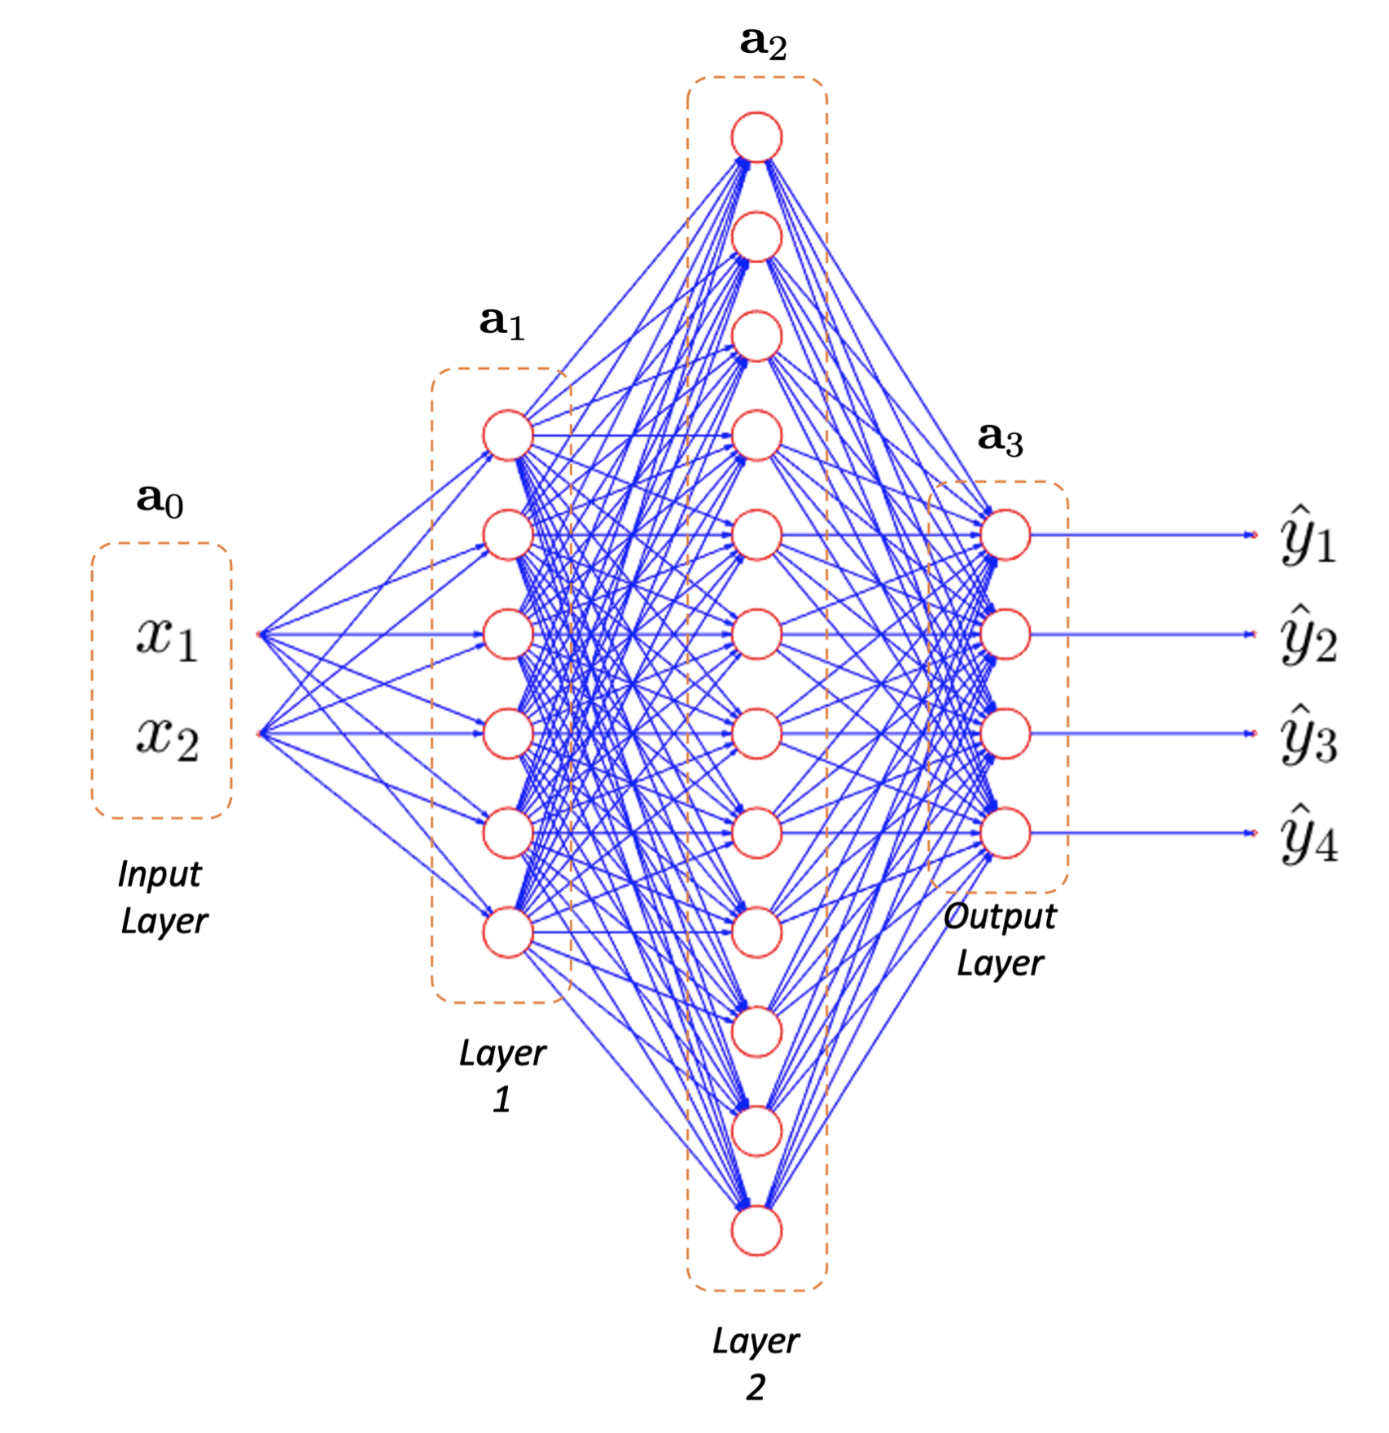
MOTIVATION
Neural networks
PAT04_DeepLearning.pptx

Slide 6
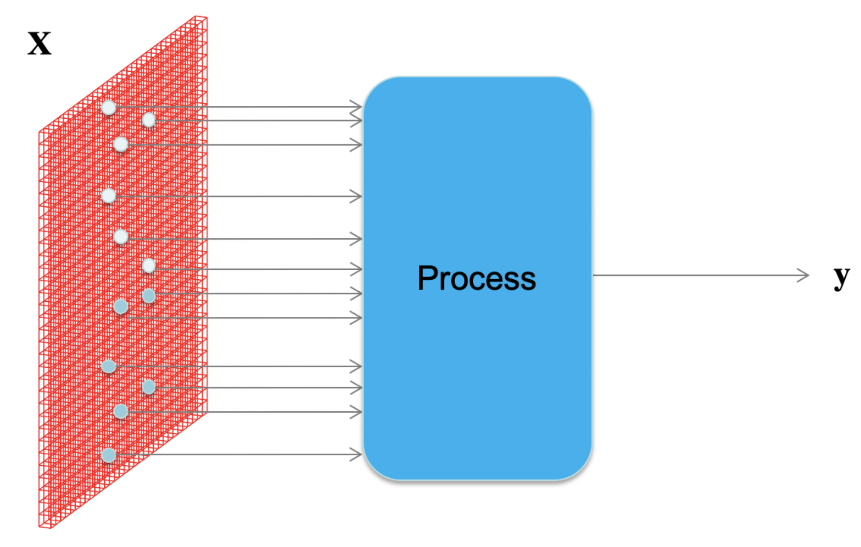
MOTIVATION
How to process an image with neural networks?
PAT04_DeepLearning.pptx

Slide 7
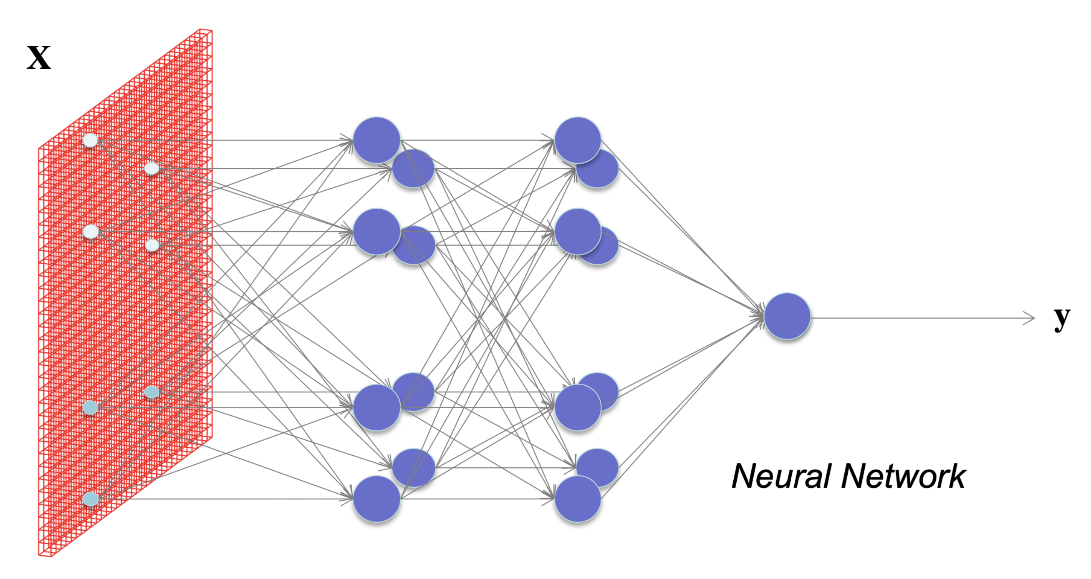

MOTIVATION
What happens if each pixel is an input?
How many neurons and weights?
PAT04_DeepLearning.pptx

Slide 8
Basics
PAT04_DeepLearning.pptx

Slide 9
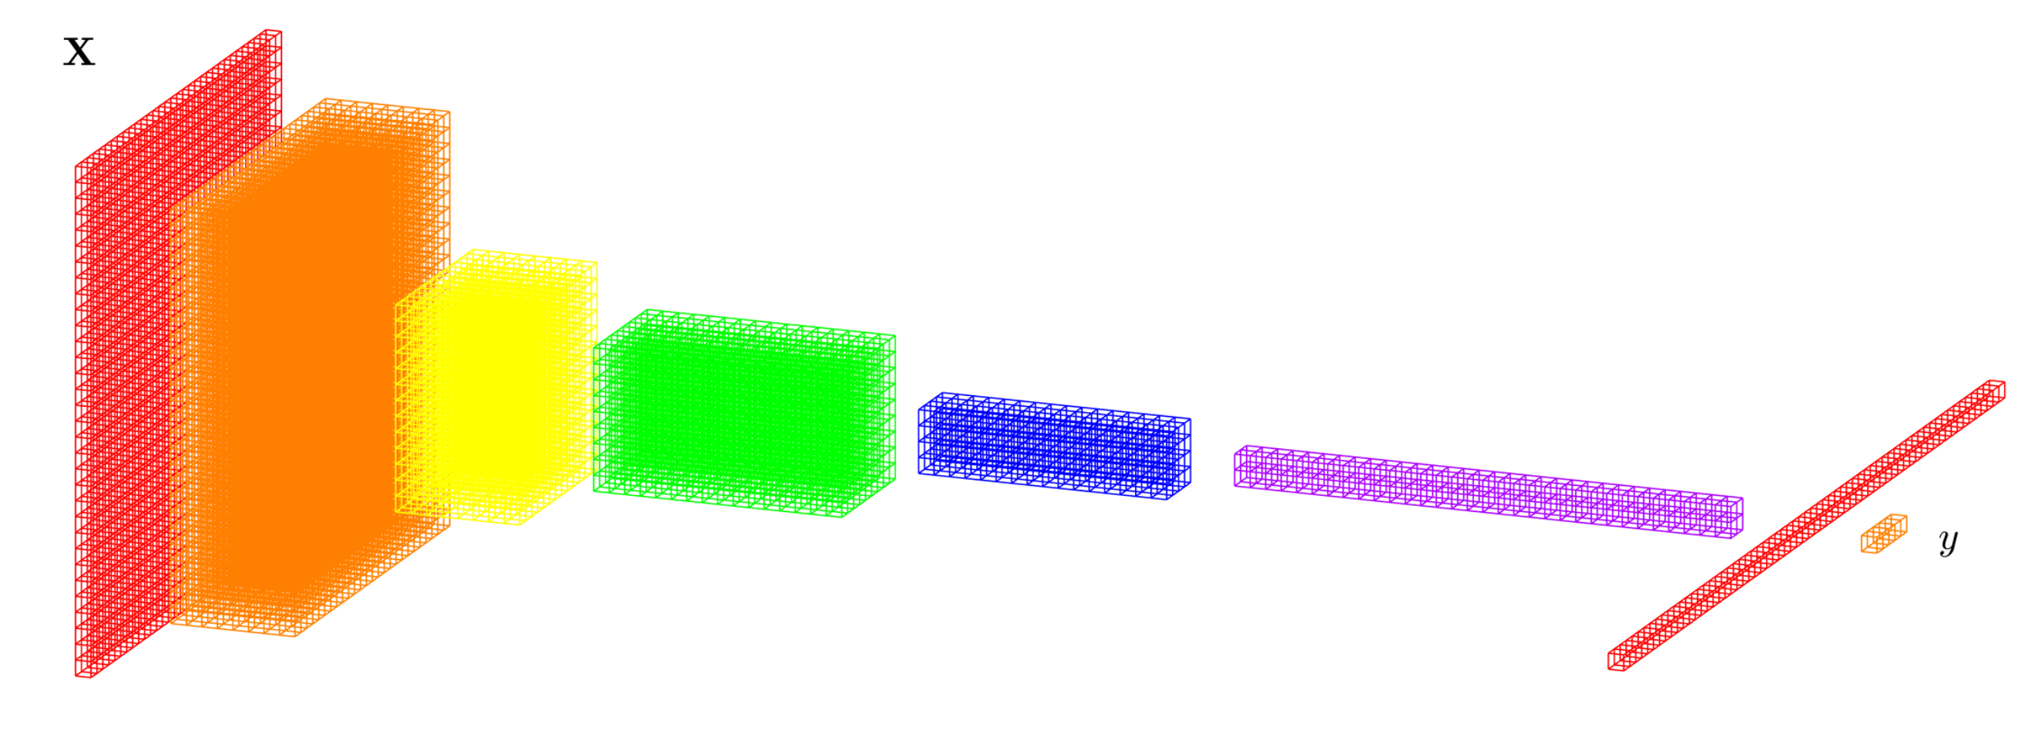
DEEP LEARNING BASICS (CNN)
Convolutional Neural Networks)
Data
representation
Input
image
Layers
Classification
PAT04_DeepLearning.pptx

Slide 10
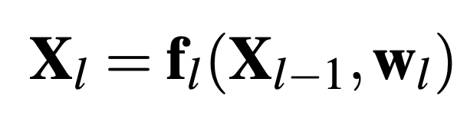
DEEP LEARNING BASICS (CNN)
Convolutional Neural Networks)
f₁
f₂
f₃
f₄
f₅
f₇
f₆
Input
image
Layers
Classification
PAT04_DeepLearning.pptx

Slide 11
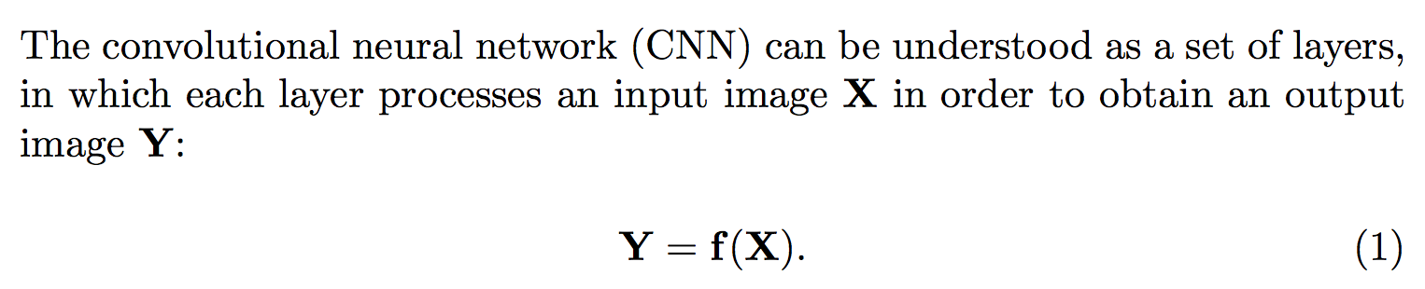
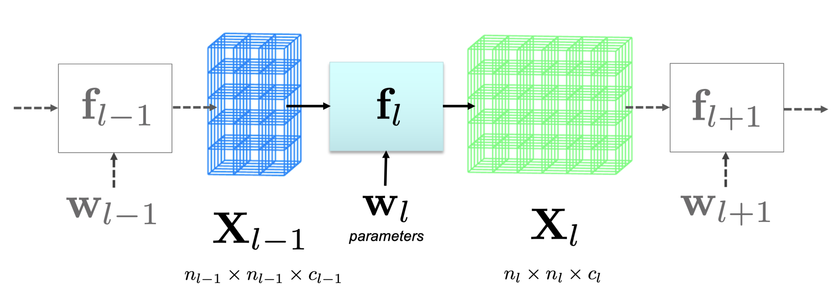
DEEP LEARNING BASICS
PAT04_DeepLearning.pptx

Slide 12
DEEP LEARNING: Typical layers
Convolution layer
Pooling layer
Rectified Linear Unit
Fully connected and SoftMax
PAT04_DeepLearning.pptx

Slide 13
DEEP LEARNING: Typical layers
Convolution layer
Pooling layer
Rectified Linear Unit
Fully connected and SoftMax
PAT04_DeepLearning.pptx

Slide 14
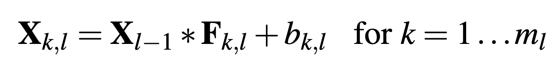
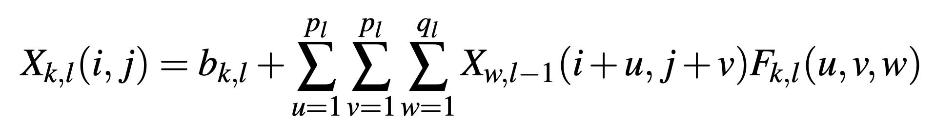
DEEP LEARNING: Convolution layer
PAT04_DeepLearning.pptx

Slide 15
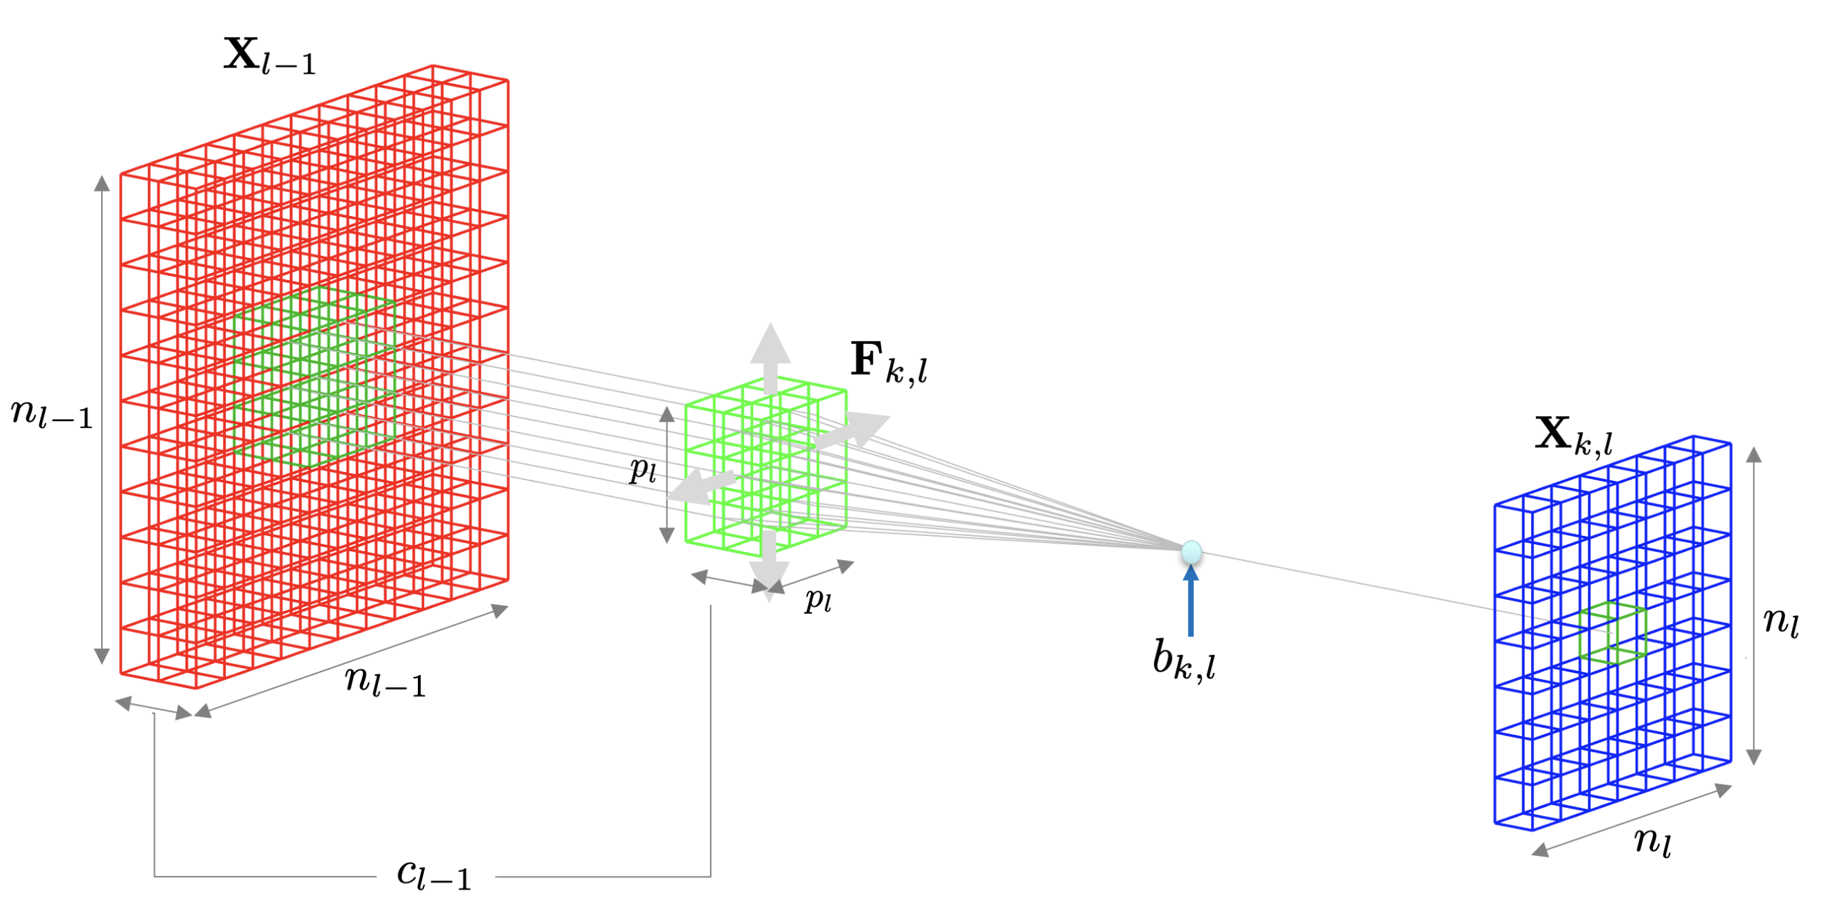
DEEP LEARNING: Convolution layer
PAT04_DeepLearning.pptx

Slide 16
DEEP LEARNING: Typical layers
Convolution layer
Pooling layer
Rectified Linear Unit
Fully connected and SoftMax
PAT04_DeepLearning.pptx

Slide 17
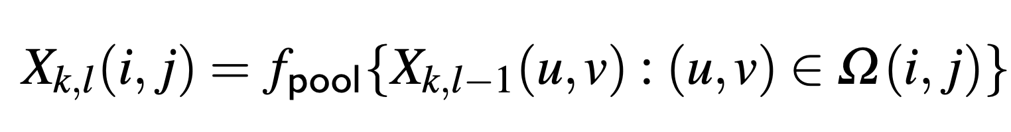
DEEP LEARNING: Pooling layer
PAT04_DeepLearning.pptx

Slide 18
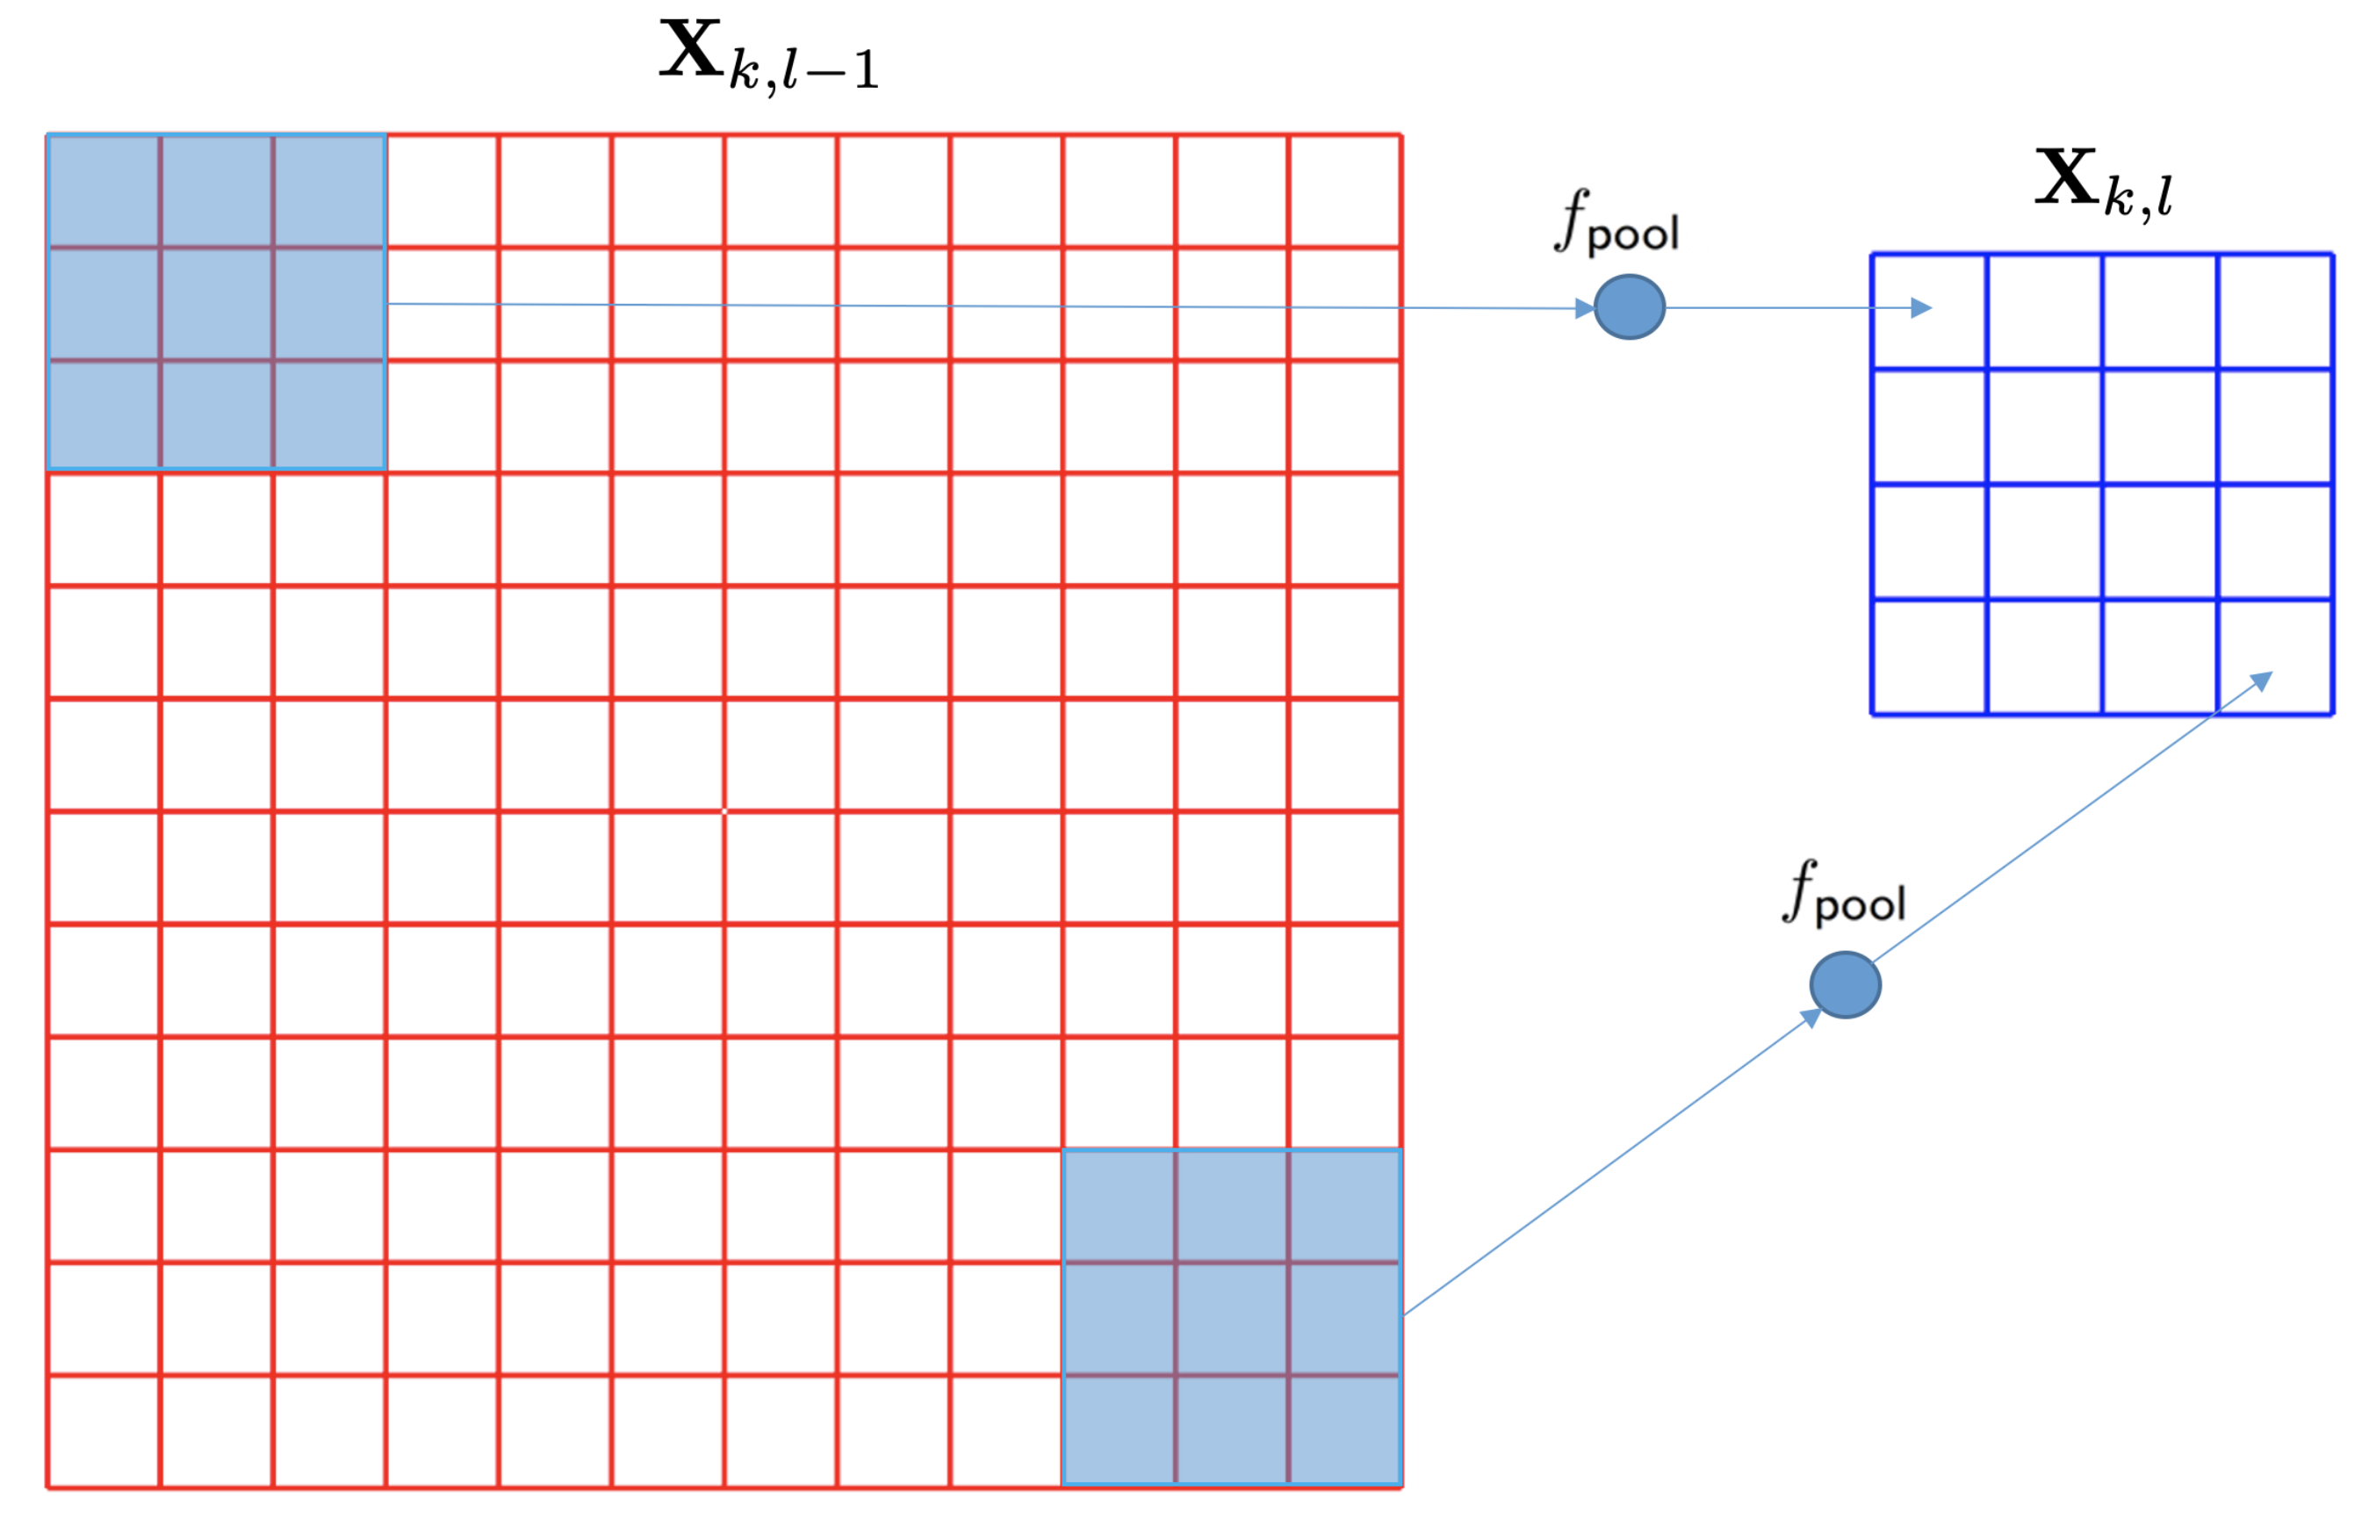
DEEP LEARNING: Pooling layer
PAT04_DeepLearning.pptx

Slide 19
DEEP LEARNING: Typical layers
Convolution layer
Pooling layer
Rectified Linear Unit
Fully connected and SoftMax
PAT04_DeepLearning.pptx

Slide 20
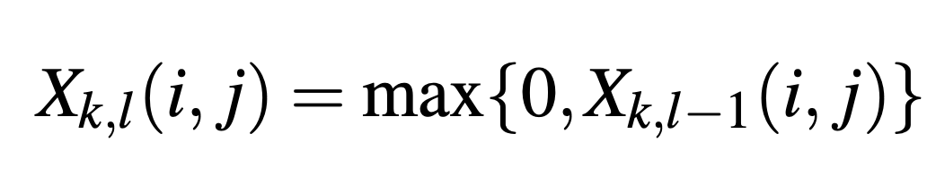
DEEP LEARNING: Rectified Linear Unit (ReLU)
PAT04_DeepLearning.pptx

Slide 21
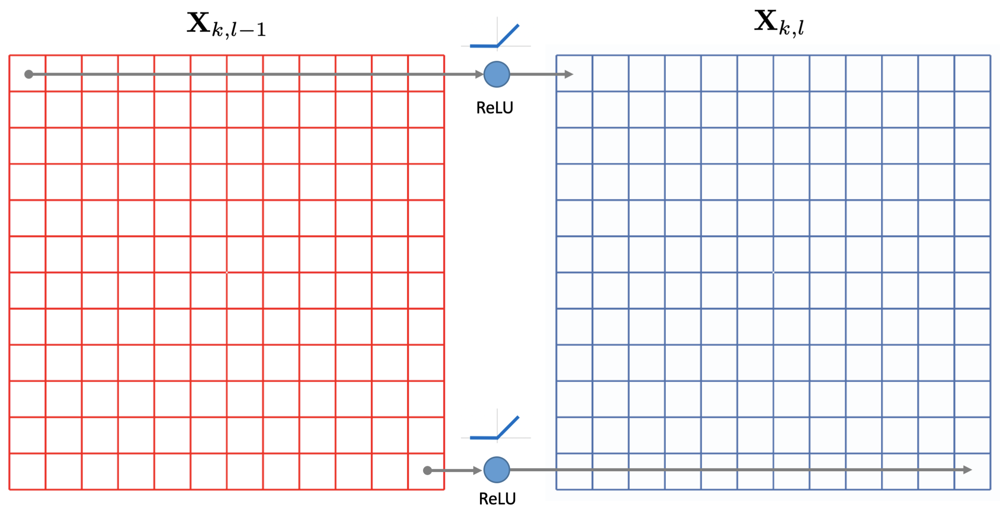
DEEP LEARNING: Rectified Linear Unit (ReLU)
PAT04_DeepLearning.pptx

Slide 22
DEEP LEARNING: Typical layers
Convolution layer
Pooling layer
Rectified Linear Unit
Fully connected and SoftMax
PAT04_DeepLearning.pptx

Slide 23
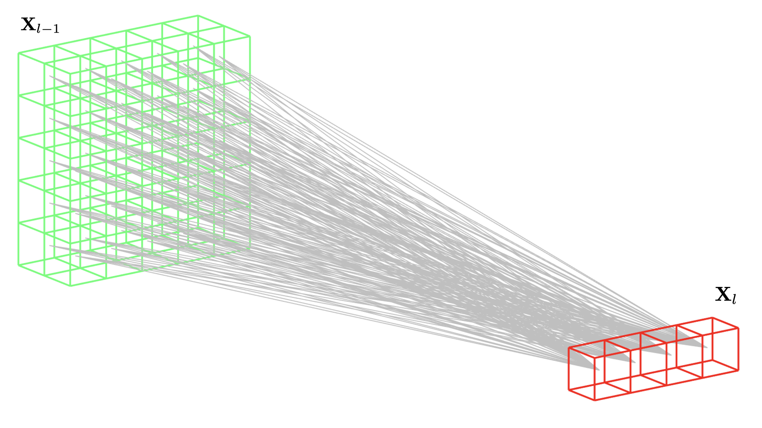
DEEP LEARNING: Fully Connected
PAT04_DeepLearning.pptx

Slide 24
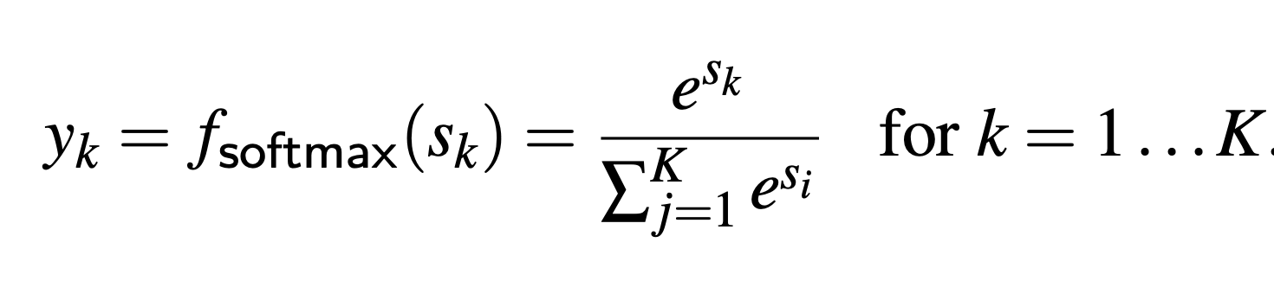
DEEP LEARNING: Fully Connected + SoftMax
PAT04_DeepLearning.pptx

Slide 25
Training
PAT04_DeepLearning.pptx

Slide 26
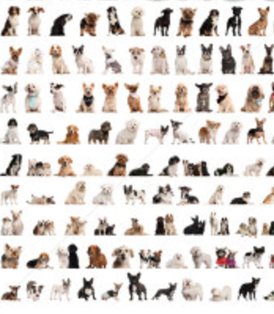


DEEP LEARNING: Training
dogs
errors
cats
Back-propagation
PAT04_DeepLearning.pptx

Slide 27
Example
Eyes vs. Nose Recognizer
PAT04_DeepLearning.pptx

Slide 28
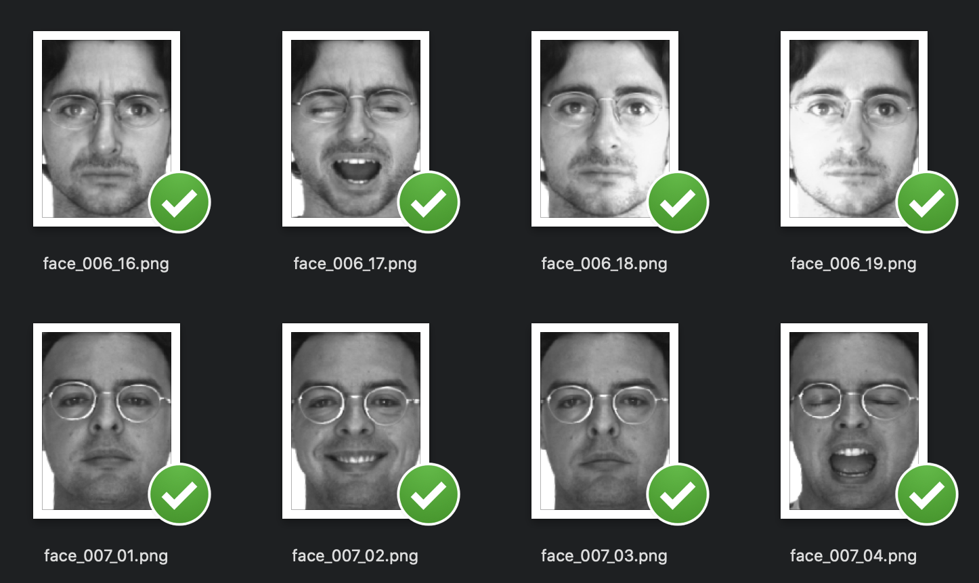
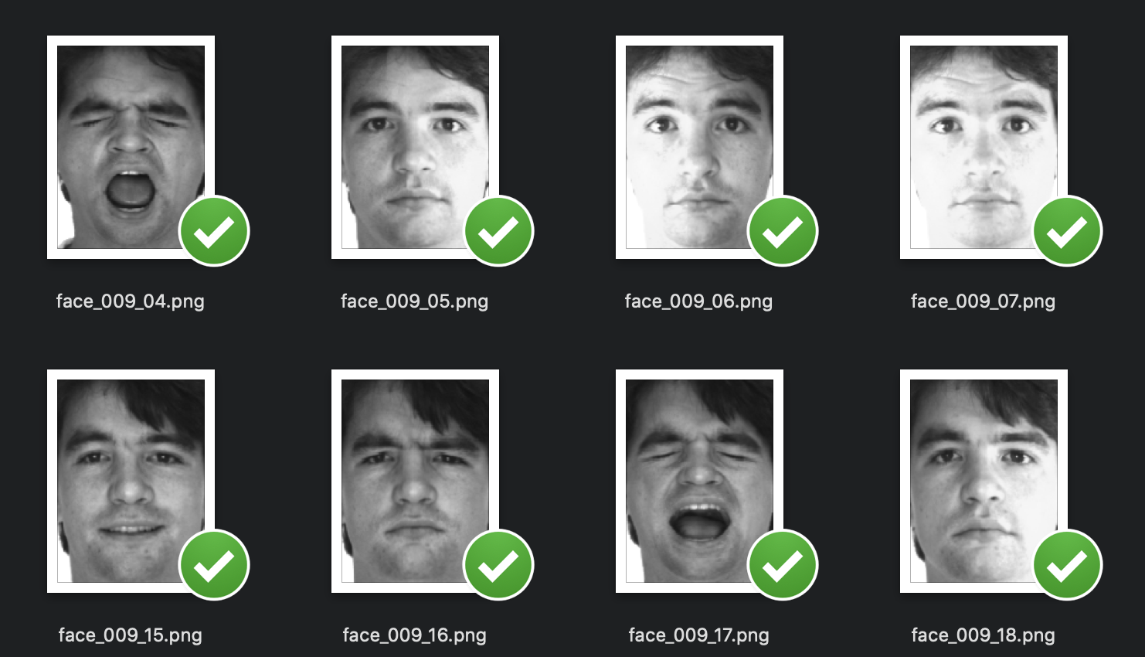
PAT04_DeepLearning.pptx

Slide 29
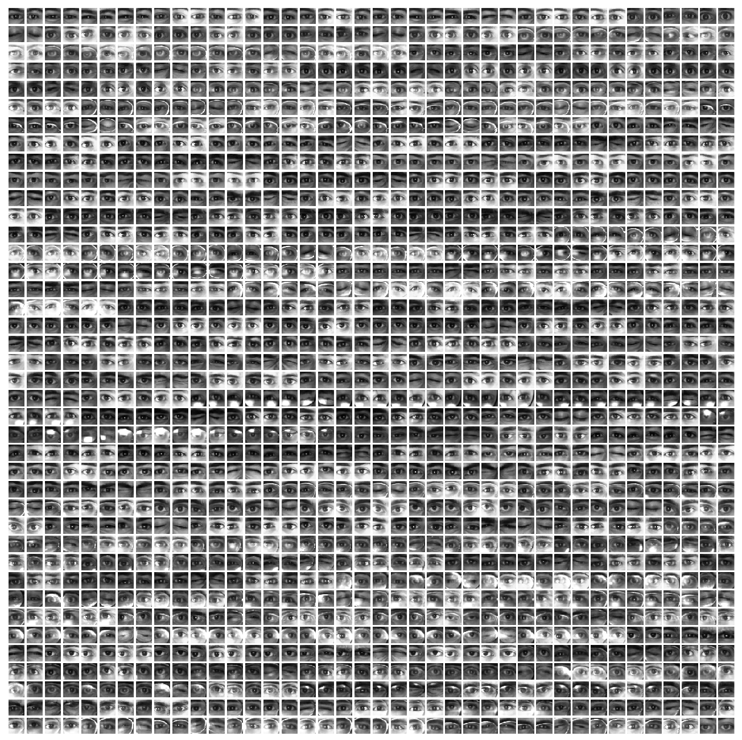
Eyes

Slide 30
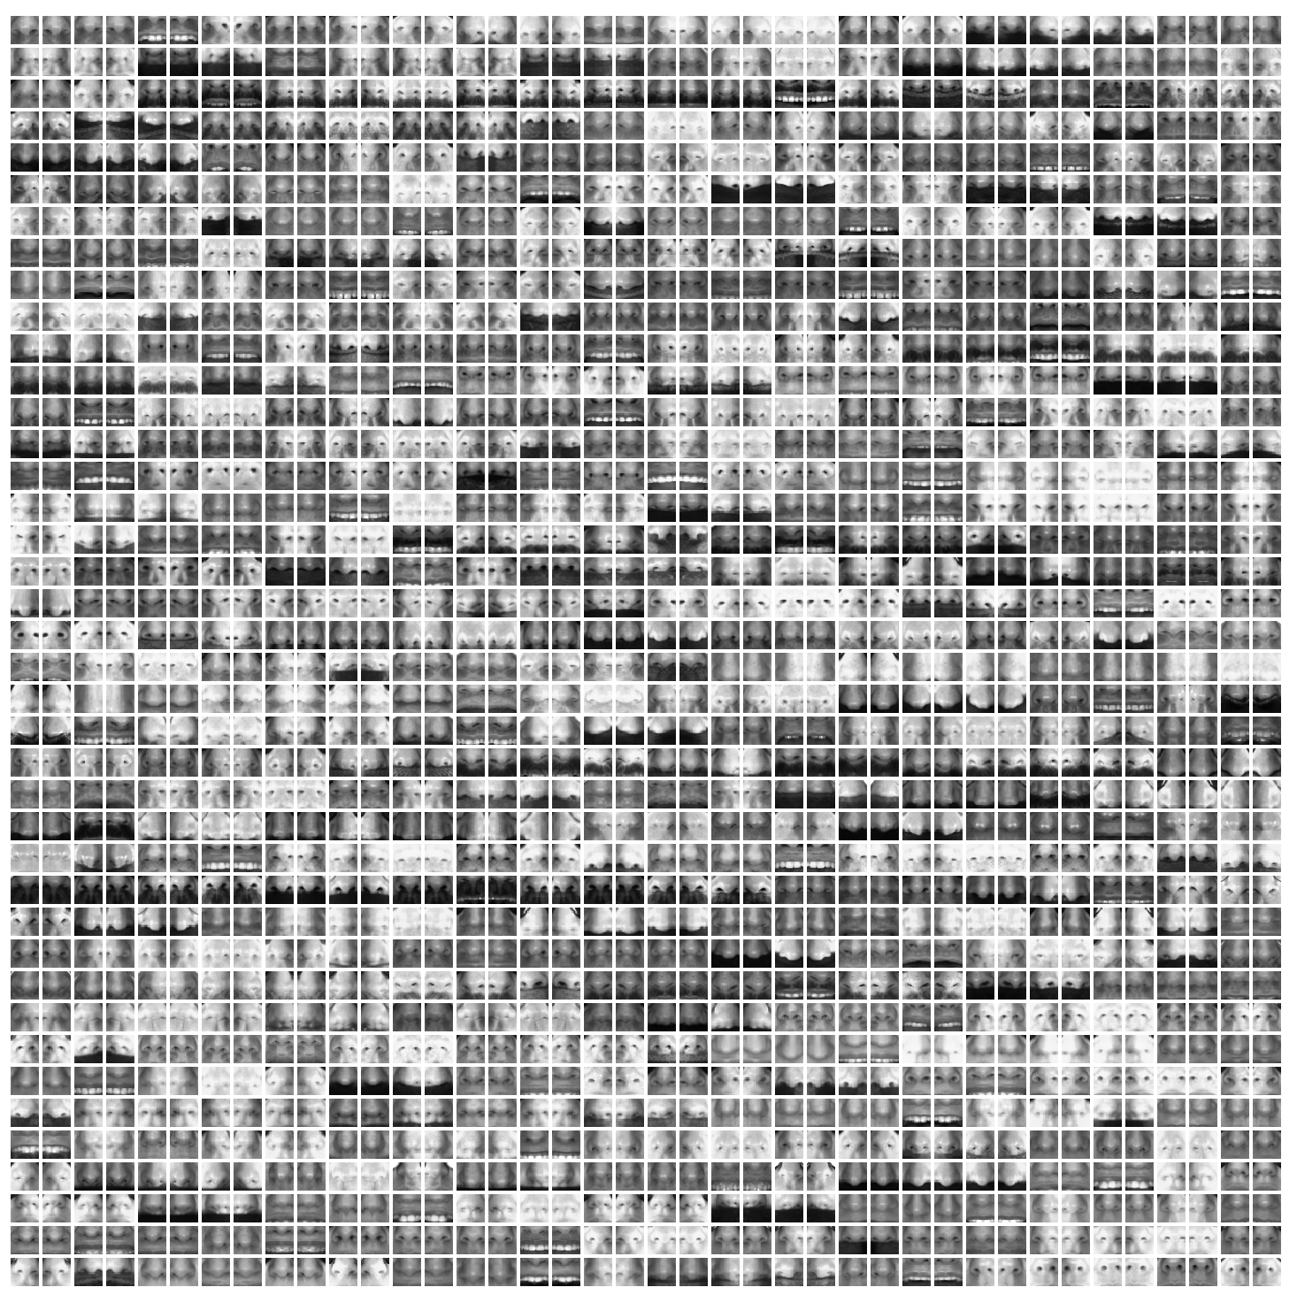
Noses

Slide 31
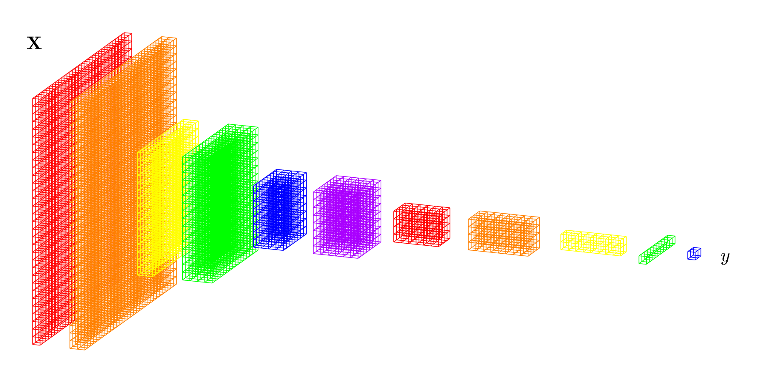
PAT04_DeepLearning.pptx

Slide 32
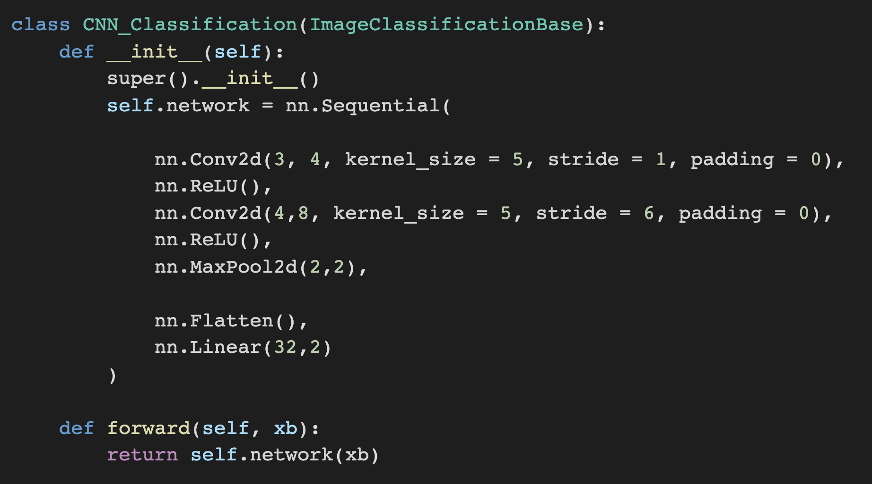
Implementation in PyTorch

Slide 33
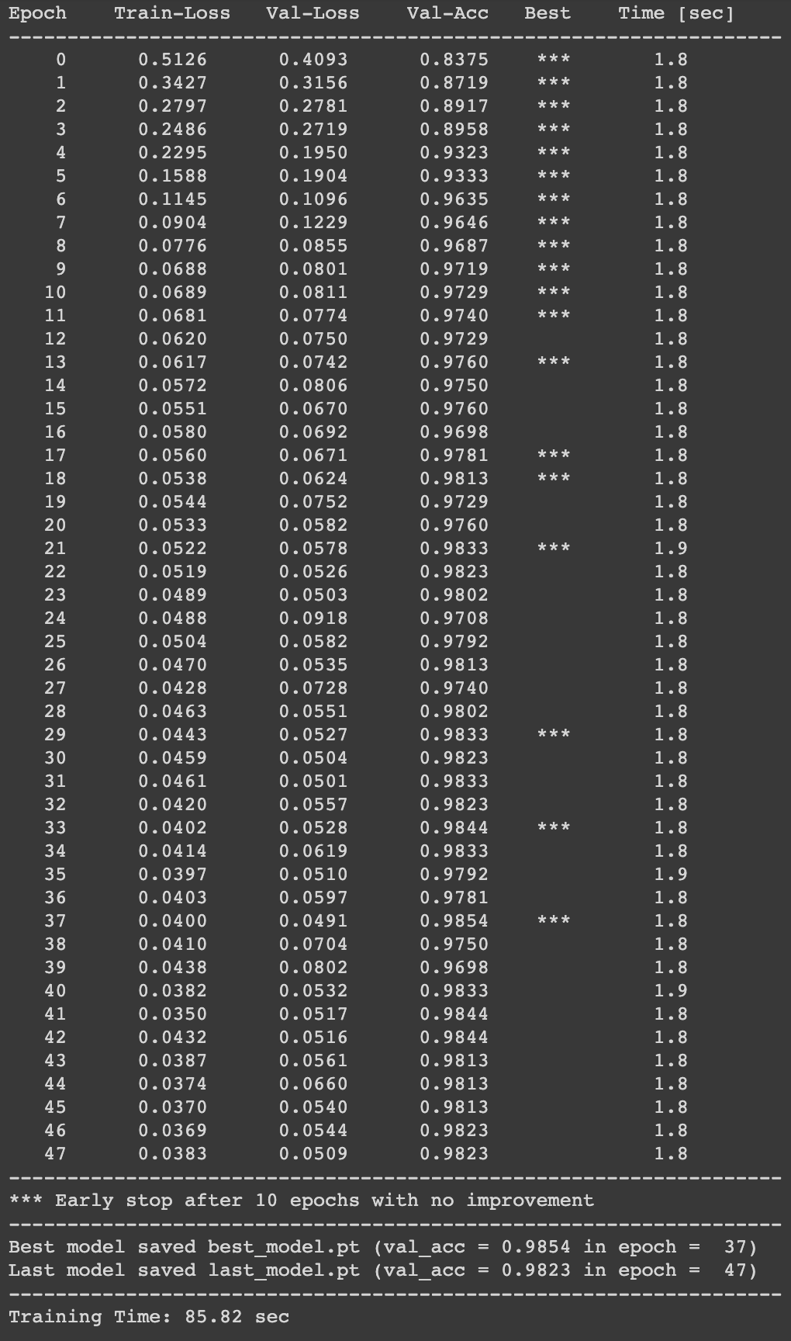
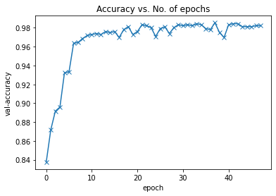
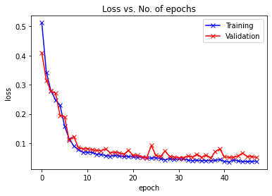

Slide 34
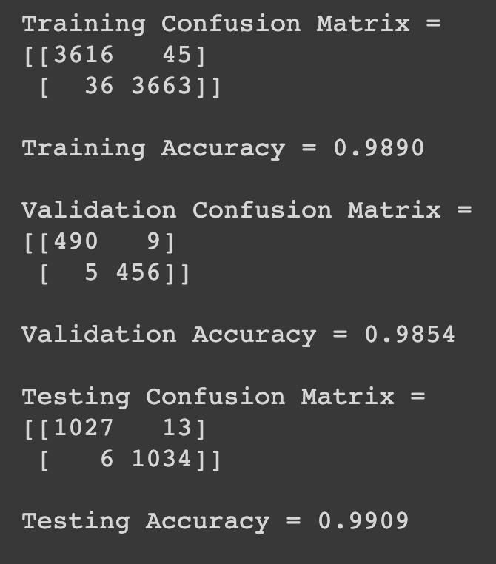

Slide 35
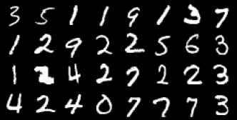
More Examples: MNIST
PAT04_DeepLearning.pptx

Slide 36
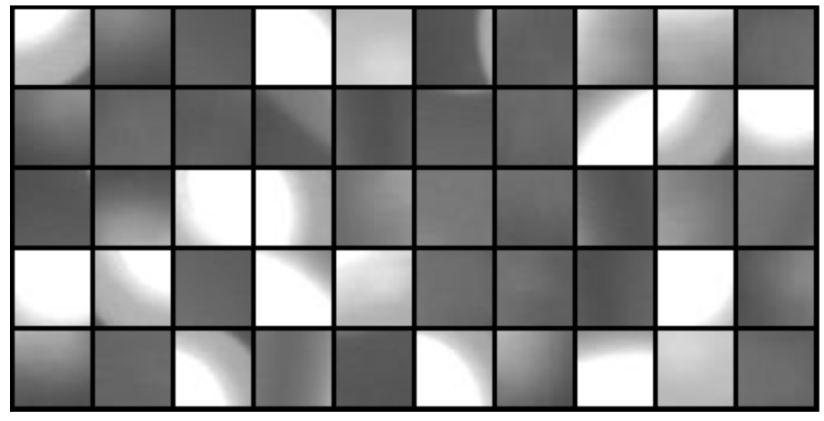
More Examples: Defects
PAT04_DeepLearning.pptx

Slide 37
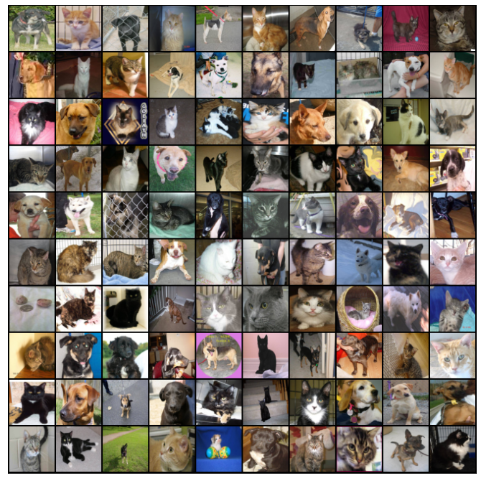
More Examples: Cats vs Dogs
PAT04_DeepLearning.pptx

Slide 38
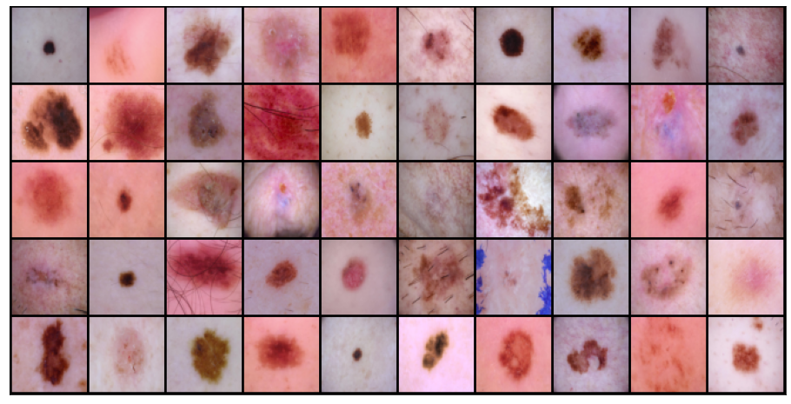
More Examples: Skin Cancer 2
PAT04_DeepLearning.pptx

Slide 39
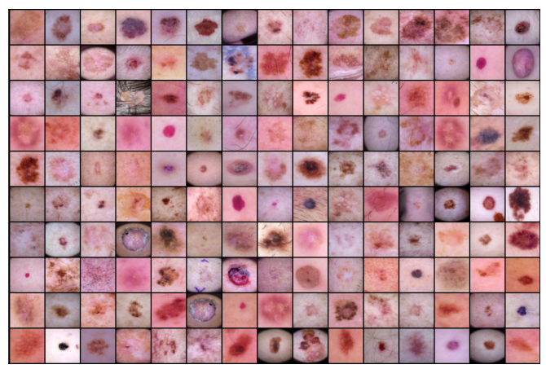
More Examples: Skin Cancer 7
PAT04_DeepLearning.pptx

Slide 40
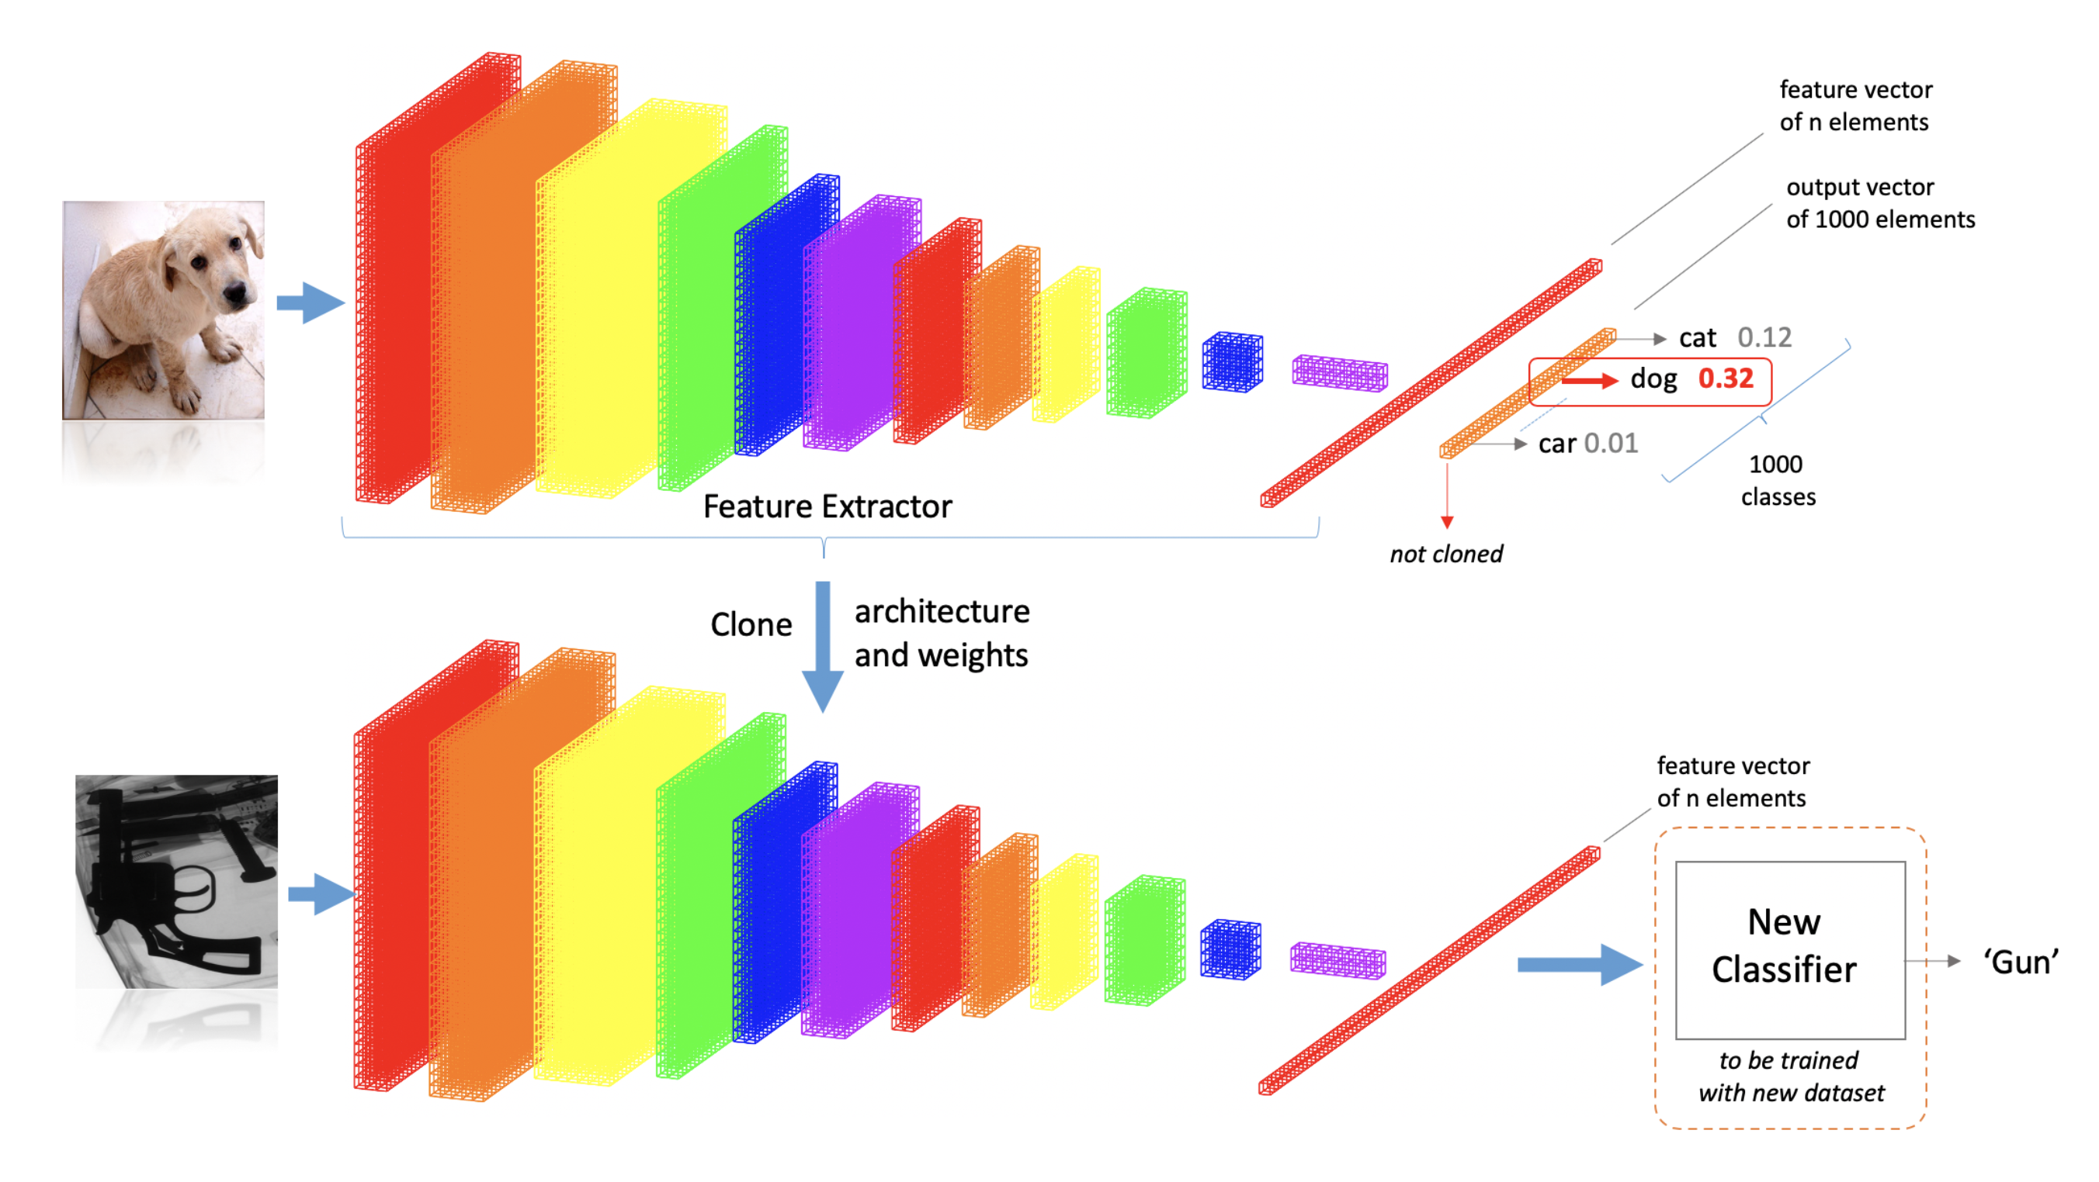
Pre-Trained Models
PAT04_DeepLearning.pptx

Slide 41
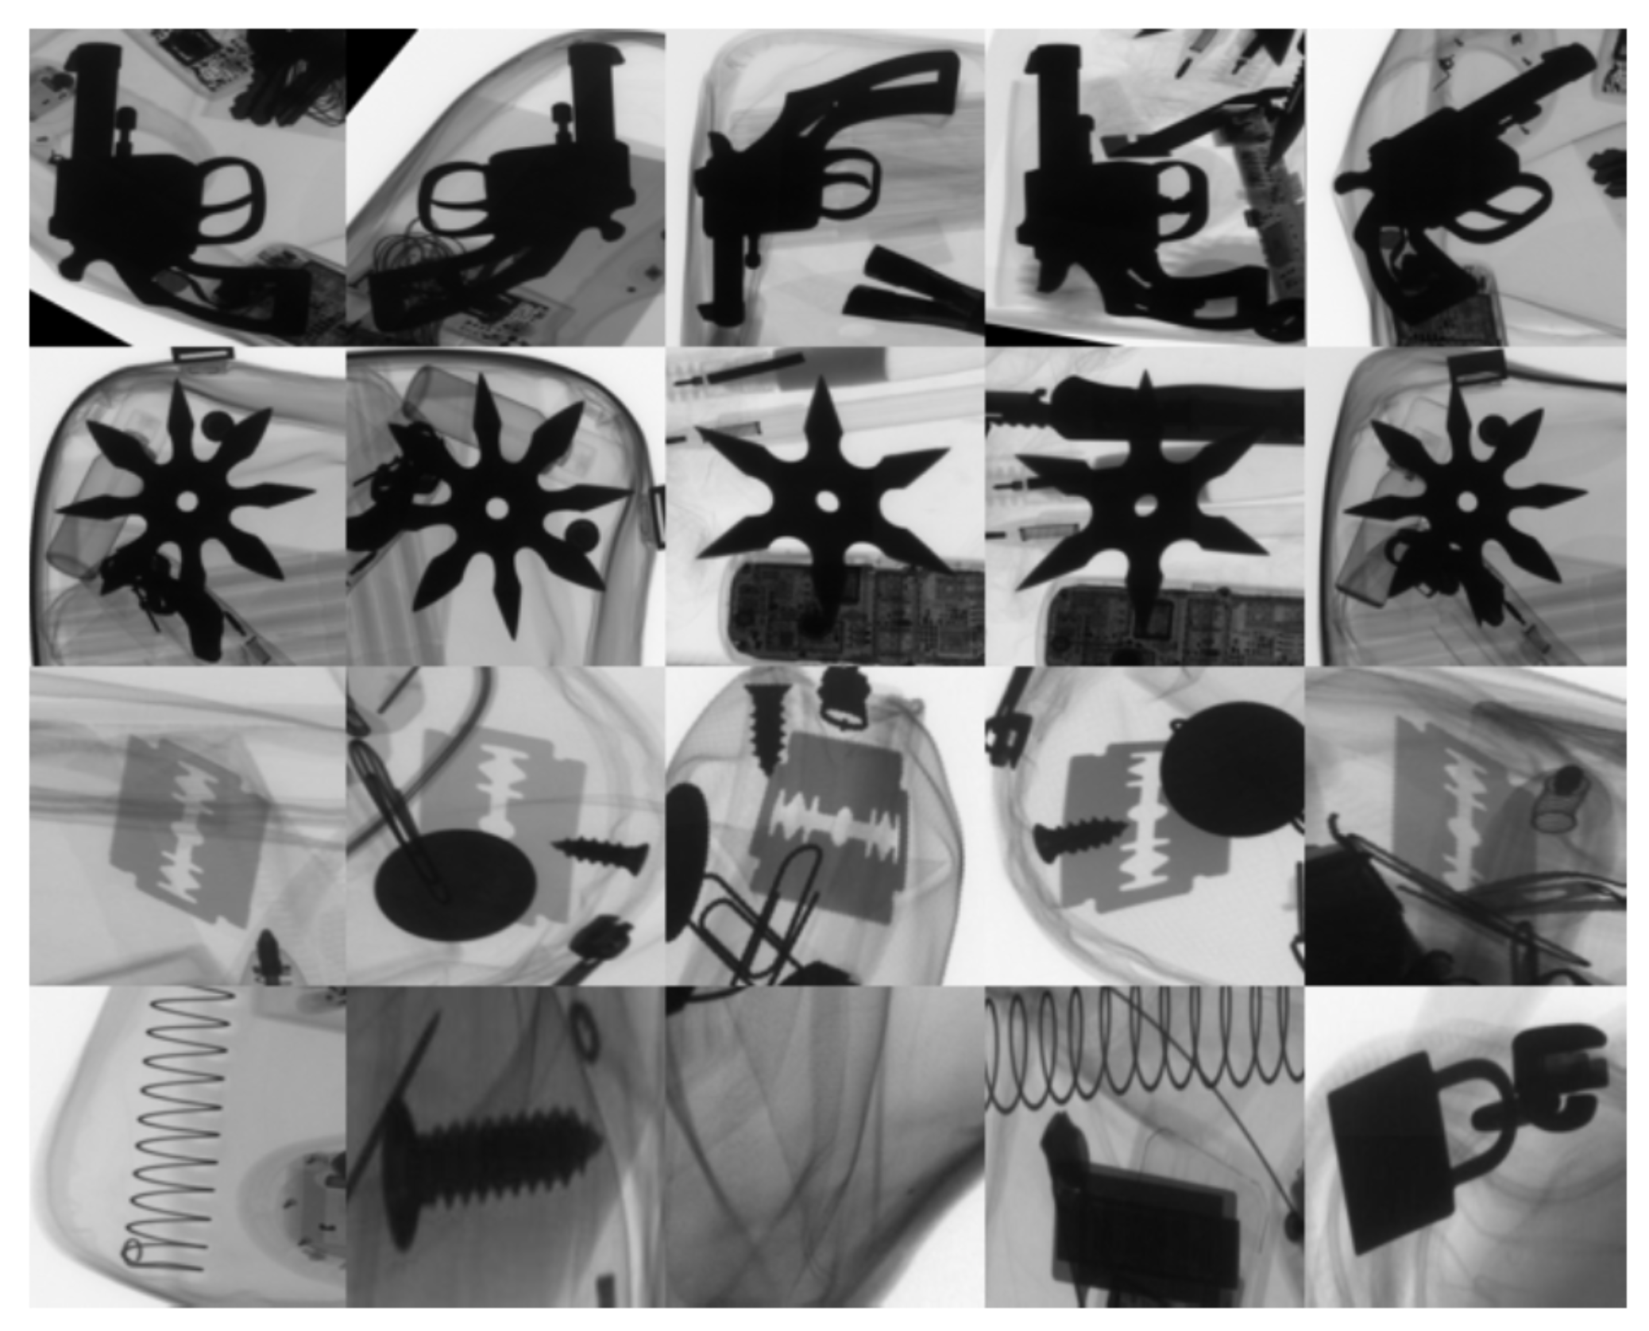

Slide 42
